Slide 1

Optimizing Task Scheduling with Limited Session Time
This presentation explores task scheduling in the context of limited session time, employing a greedy approach and dynamic programming techniques to optimize scheduling decisions and minimize work sessions.

Slide 2
Problem Statement and Objectives
Imagine having a limited time for work each day. The challenge is to schedule tasks effectively to complete them all within the allotted time.
Goal
Constraints
Objectives
Minimize the total number of work sessions required to complete all tasks.
Each task has a fixed duration, and you can only work on one task at a time.
Develop algorithms to find the optimal task schedule that minimizes work sessions.

Slide 3
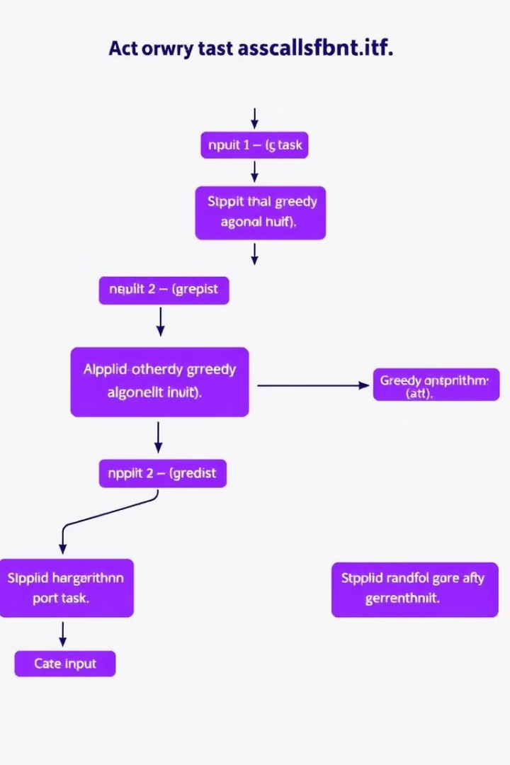
Greedy Approach to Task Scheduling
The greedy approach involves selecting the task with the shortest duration at each step, aiming to minimize the number of sessions.
1
Step 1
Sort tasks in ascending order of duration.
2
Step 2
Initialize a current session with the shortest task.
3
Step 3
Iterate through remaining tasks, adding them to the current session until its time limit is reached.
4
Step 4
Repeat steps 2-3 for remaining tasks, creating new sessions.

Slide 4

Limitations of the Greedy Approach
While simple, the greedy approach doesn't always produce the optimal solution. It can result in suboptimal schedules that require more sessions than necessary.
1
Short-sightedness
2
Lack of Global Optimization
The greedy approach focuses on the immediate shortest task, neglecting potential benefits of later task combinations.
It doesn't consider the overall schedule or the impact of choosing one task over another on later sessions.

Slide 5
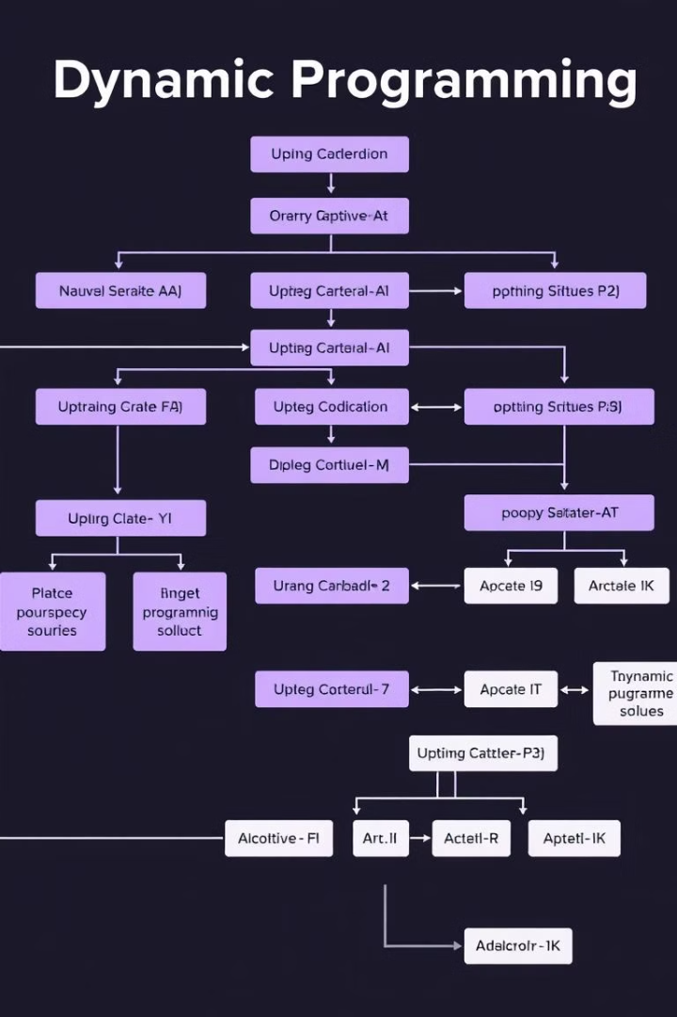
Dynamic Programming Approach to Task Scheduling
Dynamic programming offers a more comprehensive solution by systematically exploring all possible task combinations to find the optimal schedule.
Step 1
Define subproblems: Optimal schedules for subsets of tasks.
Step 2
Recursively solve subproblems, building up to the final solution.
Step 3
Store intermediate results in a table to avoid redundant computations.

Slide 6




Advantages of the Dynamic Programming Approach
The dynamic programming approach offers significant advantages over the greedy approach in finding optimal task schedules.
Optimal Solutions
Guarantees finding the absolute best schedule, minimizing the number of sessions.
Flexibility
Adaptable to various constraints and task characteristics, making it highly versatile.
Efficiency
While more complex, it often results in faster execution time, especially for larger problems.

Slide 7
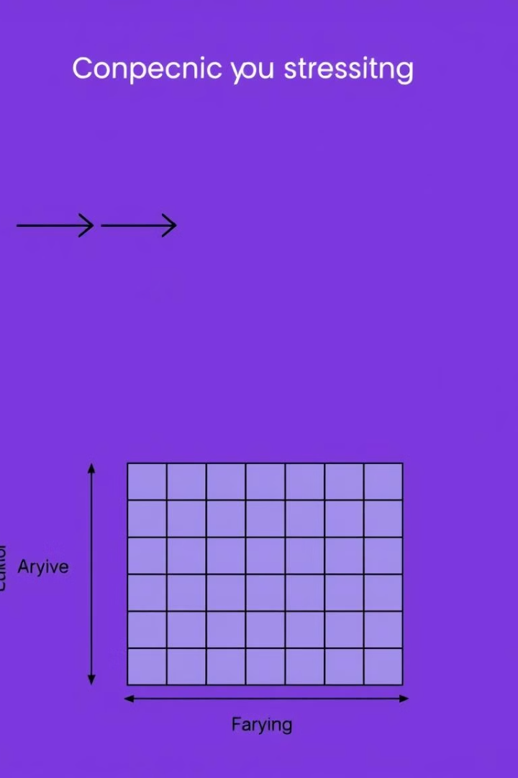


Comparison of Greedy and Dynamic Programming Approaches
While both methods offer solutions to task scheduling, they differ significantly in their approach and performance.
Greedy
Simple, fast, but can be suboptimal.
Dynamic Programming
Complex, potentially slower, but guarantees optimal results.

Slide 8

Conclusion and Future Considerations
This presentation has provided a comprehensive understanding of task scheduling using greedy and dynamic programming approaches. The choice between these approaches depends on the specific requirements and constraints of the problem.
Future Research
Applications
Explore more advanced scheduling algorithms that consider real-world factors like task dependencies, deadlines, and resource availability.
Apply these techniques to practical scheduling problems in various domains, including project management, manufacturing, and resource allocation.

